Slide 1

CS_225 Operating System
Fall 2025
Course Instructor:
Ms. Seemab Khan- Lecturer (Software Engineering )
Department of Creative Technologies
Air University - Islamabad
Seemab.khan@mail.au.edu.pk

Slide 2
Chapter 3: Processes
Process Concept
Process Scheduling
Operations on Processes
Interprocess Communication
Examples of IPC Systems
Communication in Client-Server Systems

Slide 3
Objectives
To introduce the notion of a process -- a program in execution, which forms the basis of all computation
To describe the various features of processes, including scheduling, creation and termination, and communication
To explore inter-process communication using shared memory and message passing
To describe communication in client-server systems

Slide 4
Interprocess Communication
Processes within a system may be independent or cooperating
Cooperating process can affect or be affected by other processes, including sharing data
Reasons for cooperating processes:
  Information sharing
  Computation speedup
  Modularity
  Convenience
Cooperating processes need interprocess communication (IPC)
Two models of IPC
  Shared memory
  Message passing

Slide 5

Communications Models
(a) Message passing. (b) shared memory.

Slide 6
Cooperating Processes
Independent process cannot affect or be affected by the execution of another process
Cooperating process can affect or be affected by the execution of another process
Advantages of process cooperation
  Information sharing
  Computation speed-up
  Modularity
  Convenience

Slide 7
Interprocess Communication – Shared Memory
An area of memory shared among the processes that wish to communicate
The communication is under the control of the users processes not the operating system.
Major issues is to provide mechanism that will allow the user processes to synchronize their actions when they access shared memory.

Slide 8
Producer-Consumer Problem
Paradigm for cooperating processes, producer process produces information that is consumed by a consumer process
  unbounded-buffer places no practical limit on the size of the buffer
  bounded-buffer assumes that there is a fixed buffer size
Notes:
consumer problem uses shared memory we must have
available a buffer of items that can be filled by the producer and emptied by the consumer. This buffer will reside in a region of memory that is shared by the producer and consumer processes.
A producer can produce one item while the consumer is consuming another item.The producer and consumer must be synchronized, so that the consumer does not try to consume an item that has not yet been produced.

Slide 9
Bounded-Buffer – Shared-Memory Solution
Shared data
      #define BUFFER_SIZE 10
      typedef struct {
      . . .
      } item;
      item buffer[BUFFER_SIZE];
      int in = 0;
      int out = 0;
Solution is correct, but can only use BUFFER_SIZE-1 elements

Slide 10
Bounded-Buffer – Producer
item next_produced;
while (true) {
/* produce an item in next produced */
while (((in + 1) % BUFFER_SIZE) == out)
; /* do nothing */
buffer[in] = next_produced;
in = (in + 1) % BUFFER_SIZE;
}

Slide 11
Bounded Buffer – Consumer
item next_consumed;
while (true) {
while (in == out)
; /* do nothing */
next_consumed = buffer[out];
out = (out + 1) % BUFFER_SIZE;
/* consume the item in next consumed */
}

Slide 12
Interprocess Communication – Message Passing
Mechanism for processes to communicate and to synchronize their actions
Message system – processes communicate with each other without resorting to shared variables
IPC facility provides two operations:
  send(message)
  receive(message)
The message size is either fixed or variable

Slide 13
Message Passing (Cont.)
If processes P and Q wish to communicate, they need to:
  Establish a communication link between them
  Exchange messages via send/receive
Implementation issues:
  How are links established?
  Can a link be associated with more than two processes?
  How many links can there be between every pair of communicating processes?
  What is the capacity of a link?
  Is the size of a message that the link can accommodate fixed or variable?
  Is a link unidirectional or bi-directional?

Slide 14
Message Passing (Cont.)
Implementation of communication link
  Physical:
    Shared memory
    Hardware bus
    Network
  Logical:
    Direct or indirect
    Synchronous or asynchronous
    Automatic or explicit buffering

Slide 15
Direct Communication
Processes must name each other explicitly:
  send (P, message) – send a message to process P
  receive(Q, message) – receive a message from process Q
Properties of communication link
  Links are established automatically
  A link is associated with exactly one pair of communicating processes
  Between each pair there exists exactly one link
  The link may be unidirectional, but is usually bi-directional

Slide 16
Indirect Communication
Messages are directed and received from mailboxes (also referred to as ports)
  Each mailbox has a unique id
  Processes can communicate only if they share a mailbox
Properties of communication link
  Link established only if processes share a common mailbox
  A link may be associated with many processes
  Each pair of processes may share several communication links
  Link may be unidirectional or bi-directional

Slide 17
Indirect Communication
Operations
  create a new mailbox (port)
  send and receive messages through mailbox
  destroy a mailbox
Primitives are defined as:
send(A, message) – send a message to mailbox A
receive(A, message) – receive a message from mailbox A

Slide 18
Indirect Communication
Mailbox sharing
  P₁, P₂, and P₃ share mailbox A
  P₁, sends; P₂ and P₃ receive
  Who gets the message?
Solutions
  Allow a link to be associated with at most two processes
  Allow only one process at a time to execute a receive operation
  Allow the system to select arbitrarily the receiver. Sender is notified who the receiver was.

Slide 19
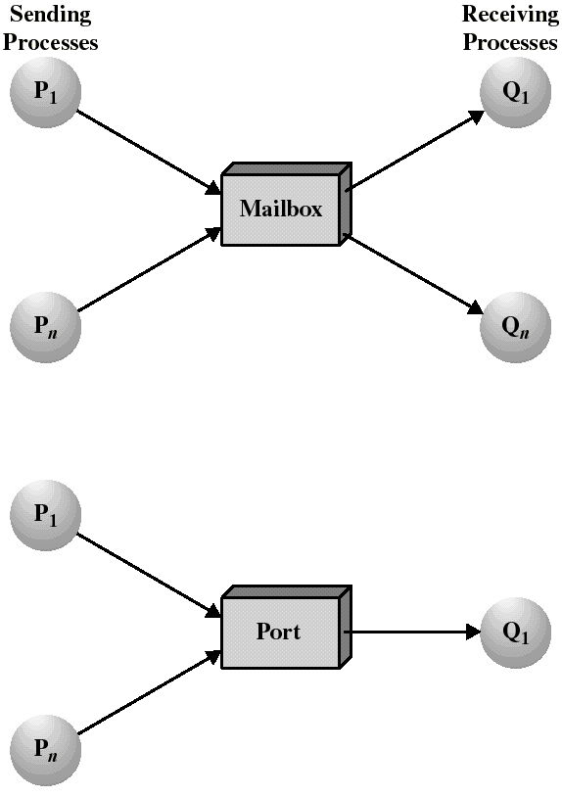
Mailboxes and Ports
A mailbox can be private to one sender/receiver pair.
The same mailbox can be shared among several senders and receivers:
  the OS may then allow the use of message types (for selection).
Port: is a mailbox associated with one receiver and multiple senders
  used for client/server applications: the receiver is the server.

Slide 20
Synchronization
Message passing may be either blocking or non-blocking
Blocking is considered synchronous
  Blocking send -- the sender is blocked until the message is received
  Blocking receive -- the receiver is blocked until a message is available
Non-blocking is considered asynchronous
  Non-blocking send -- the sender sends the message and continue
  Non-blocking receive -- the receiver receives:
    A valid message, or
    Null message
Different combinations possible
  If both send and receive are blocking, we have a rendezvous

Slide 21
Synchronization (Cont.)
Producer-consumer becomes trivial
message next_produced;
while (true) {
/* produce an item in next produced */
send(next_produced);
}
message next_consumed;
while (true) {
receive(next_consumed);
/* consume the item in next consumed */
}

Slide 22
Buffering
Queue of messages attached to the link.
implemented in one of three ways
  1. Zero capacity – no messages are queued on a link.
  Sender must wait for receiver (rendezvous)
  2. Bounded capacity – finite length of n messages
  Sender must wait if link full
  3. Unbounded capacity – infinite length
  Sender never waits

Slide 23
Examples of IPC Systems - Mach
Mach communication is message based
  Even system calls are messages
  Each task gets two mailboxes at creation- Kernel and Notify
  Only three system calls needed for message transfer
  msg_send(), msg_receive(), msg_rpc()
  Mailboxes needed for commuication, created via
  port_allocate()
  Send and receive are flexible, for example four options if mailbox full:
    Wait indefinitely
    Wait at most n milliseconds
    Return immediately
    Temporarily cache a message

Slide 24
Examples of IPC Systems – Windows
Message-passing centric via advanced local procedure call (LPC) facility
  Only works between processes on the same system
  Uses ports (like mailboxes) to establish and maintain communication channels
  Communication works as follows:
    The client opens a handle to the subsystem’s connection port object.
    The client sends a connection request.
    The server creates two private communication ports and returns the handle to one of them to the client.
    The client and server use the corresponding port handle to send messages or callbacks and to listen for replies.

Slide 25

Local Procedure Calls in Windows

Slide 26
Communications in Client-Server Systems
Sockets
Remote Procedure Calls
Pipes
Remote Method Invocation (Java)

Slide 27
Sockets
A socket is defined as an endpoint for communication
Concatenation of IP address and port – a number included at start of message packet to differentiate network services on a host
The socket 161.25.19.8:1625 refers to port 1625 on host 161.25.19.8
Communication consists between a pair of sockets
All ports below 1024 are well known, used for standard services
Special IP address 127.0.0.1 (loopback) to refer to system on which process is running

Slide 28

Socket Communication

Slide 29

Sockets in Java
Three types of sockets
  Connection-oriented (TCP)
  Connectionless (UDP)
  MulticastSocket class– data can be sent to multiple recipients
Consider this “Date” server:

Slide 30
Remote Procedure Calls
Remote procedure call (RPC) abstracts procedure calls between processes on networked systems
  Again uses ports for service differentiation
Stubs – client-side proxy for the actual procedure on the server
The client-side stub locates the server and marshalls the parameters
The server-side stub receives this message, unpacks the marshalled parameters, and performs the procedure on the server
On Windows, stub code compile from specification written in Microsoft Interface Definition Language (MIDL)
Notes:
The RPC system hides the details that allow communication to take place by providing a stubon the client side.
A stub in distributed computing is a piece of code that converts parameters passed between client and server during a remote procedure call (RPC).
Parameter marshalling involves packaging the parameters into a form that can be transmitted over a network

Slide 31

Execution of RPC

Slide 32
Pipes
Acts as a conduit allowing two processes to communicate
Issues:
  Is communication unidirectional or bidirectional?
  In the case of two-way communication, is it half or full-duplex?
  Must there exist a relationship (i.e., parent-child) between the communicating processes?
  Can the pipes be used over a network?
Ordinary pipes – cannot be accessed from outside the process that created it. Typically, a parent process creates a pipe and uses it to communicate with a child process that it created.
Named pipes – can be accessed without a parent-child relationship.

Slide 33

Ordinary Pipes
Ordinary Pipes allow communication in standard producer-consumer style
Producer writes to one end (the write-end of the pipe)
Consumer reads from the other end (the read-end of the pipe)
Ordinary pipes are therefore unidirectional
Require parent-child relationship between communicating processes
Windows calls these anonymous pipes
See Unix and Windows code samples in textbook

Slide 34
Named Pipes
Named Pipes are more powerful than ordinary pipes
Communication is bidirectional
No parent-child relationship is necessary between the communicating processes
Several processes can use the named pipe for communication
Provided on both UNIX and Windows systems

Slide 35
Examples of IPC Systems - POSIX
POSIX Shared Memory
  Process first creates shared memory segment
  shm_fd = shm_open(name, O CREAT | O RDWR, 0666);
  Also used to open an existing segment to share it
  Set the size of the object
ftruncate(shm fd, 4096);
  Now the process could write to the shared memory
  sprintf(shared memory, "Writing to shared memory");

Slide 36

IPC POSIX Producer

Slide 37

IPC POSIX Consumer

